Slide 1
Week 2: Physics I
Newton’s laws of motion and gravity predict the movement of objects on earth and in space.

Slide 2
…Last week
The scientific method is a process of inquiry that involves observation, hypothesis, prediction, testing/experimentation.
Theory: A conclusion based upon the observation of nature supported by considerable experimental and observational evidence.
Law: A broad statement about how the universe works based upon repeated and rigorous testing of a theory or group of theories.

Slide 3
The Scientific Method
See Figure 1.7 in the text.

Slide 4
Outline: Newton’s Laws
History of observation of physical events
Observation of the night sky, identification of regularities
Development of Astronomy
Ptolemy, Copernicus
Tycho Brahe and Johannes Kepler
Galileo as a Prototype for the Experimental Scientist
Isaac Newton and Universal Laws of Motion

Slide 5
Why observe the night sky?
Before calendars or clocks, planets and stars in the sky were observed to change regularly and that this change could be predicted.
Astronomical regularities informed the timing of crop harvest, hunting, and other seasonal activities although its basis was not understood.
Structures like Stonehenge built to help mark the passage of time.
Early explanations for the meaning of the movement of planets included myths or legends.

Slide 6
Astronomy
Many cultures made astronomical observations (Babylonians; Egyptians)
Greeks incorporated elements of modern science into their astronomical explanations (compiled observations from numerous astronomers)
Claudius Ptolemy (2nd century AD) proposed a model of the universe with earth at its centre (geocentric model) and the planets and sun moving around it in circular orbits

Slide 7
The Historical Background: Ptolemy
See Figure 2-4 in the text

Slide 8
Astronomy (II)
Ptolemaic system remained dominant for nearly 1600 years.
Nicolaus Copernicus (1473-1543), a Polish cleric, proposed a heliocentric alternative to Ptolemy’s geocentric universe in his treatise “On the Revolutions of the Heavenly Spheres”.

Slide 9
The Historical Background: Copernicus
See Figure 2-4 in the text

Slide 10
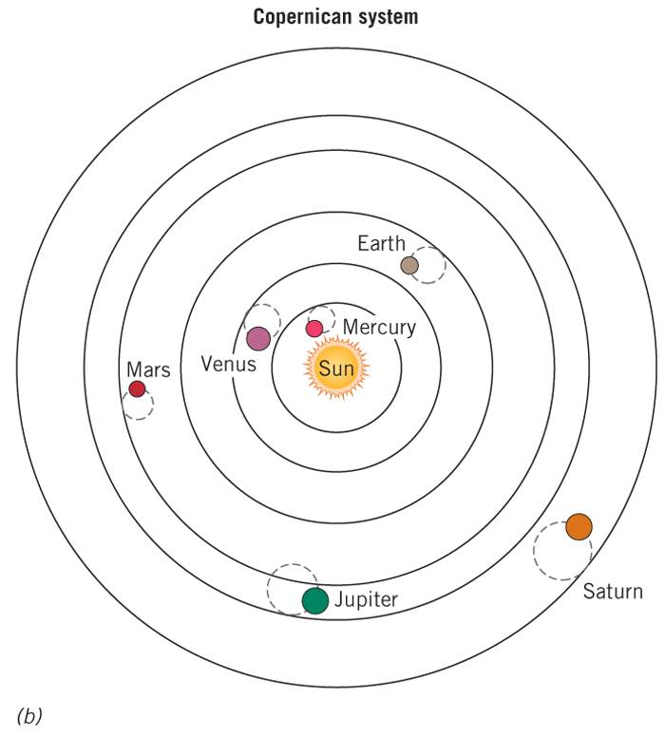
The Historical Background: Copernicus
Major features of Copernican model:
The earth is a planet and moves around the sun located near the centre of the solar system
The earth has three types of movement: annual rotation around the sun; tilting upon its axis; and daily rotation
Orbits are circular

Slide 11
The Move to Modern Astronomy
These two models carried significant social consequences; if earth was not at the centre of the universe what was the place of mankind?
Contemporary inquiries and experiments were conducted but were severely hampered by a lack of instrumentation: the telescope had not been invented and handheld instruments were insufficiently sensitive (and inaccurate).

Slide 12
A way forward…
Tycho Brahe (1546-1601), a Danish astronomer and nobleman developed improved instruments to observe the positions of planets and stars.
Tycho’s design refinements allowed measurements to be made from two angles resulting in improved accuracy and consistency in mapping astronomical phenomena.
The sighting devices were made from better-characterised materials (known composition) and their performance was more consistent.
Tycho was able to correct measurements due to metal contraction in cold weather.
Over 25 years, Tycho Brahe painstakingly collected detailed and highly accurate data about the positions of stars and planets.
Tycho Brahe died in 1601 and his data passed to his assistant a German mathematician named Johannes Kepler.

Slide 13
Kepler and Brahe
Johannes Kepler analysed Tycho’s comprehensive dataset of planetary observations.
Derived three principles or laws about the movement of planets around the sun
First law (Law of Ellipses): the orbit of every planet is an ellipse.
Second law (Law of Equal Areas): an imaginary line from the centre of the sun to the centre of the planet will sweep out equal areas in equal amounts of time.
Third law (Law of Harmonies): the ratio of the squares of the periods of any two planets is equal to ratio of the cube of their average distance from the sun.

Slide 14
Kepler’s First Law
See Figure 2-5 in the text

Slide 15
Galileo Galilei
Galileo Galilei (1654-1643) Italian physicist, inventor and philosopher was one of the first experimental scientists.
Constructed a telescope and recorded his observations which supported the model proposed by Copernicus and refined by Brahe and Kepler (published in The Starry Messenger 1610; A Dialogue Concerning Two World Systems 1632).
Invented many useful devices: thermometer, proportional compass and pendulum clock.
Conducted seminal studies into the motion of objects.

Slide 16
Some Mechanics Vocabulary
Speed: is the distance an object travels divided by time (units are km/h; m/s)
Velocity: is the same as speed except that it includes information on the direction of travel. This makes velocity a vector quantity (speed and direction).
Velocity is described by the following equation: v=d/t
Acceleration: is the rate of change of velocity (units m/s²)
Acceleration is described by the following equation:
Acceleration = (final velocity-initial velocity)/time

Slide 17
Galileo’s Falling-Ball Apparatus
See Figure 2-8

Slide 18
Galileo Galilei
Constant acceleration
Balls on a plane: v=at
Freefall
Constant acceleration at g
g = 9.8 m/s²=32 feet/s²
Distance traveled (d)=½at²

Slide 19
Equations Relating d,v,a, and t
See Table 2-1

Slide 20
The First Law
An object will continue moving in a straight line at a constant speed, and a stationary object will remain at rest, unless acted upon by an unbalanced force
Uniform motion vs. acceleration
Force
Inertia

Slide 21
The Second Law
The acceleration produced on a body by a force is proportional to the magnitude of the force and inversely proportional to the mass of the object
Equation: F=ma

Slide 22
The Third Law
Interacting objects exert equal but opposite forces upon each other
The reactions may not be equal and opposite

Slide 23
Momentum

Slide 24
Momentum
Motion depends on mass and speed
Linear momentum:
p=mv
Law of conservation of linear momentum
Angular momentum

Slide 25
The Law of Conservation of Linear Momentum
See Figure 2-16

Slide 26
The Conservation of Angular Momentum
See Figure 2-17

Slide 27
The Universal Force of Gravity

Slide 28
The Universal Force of Gravity
Gravity
Newton’s law of universal gravitation
F=Gm₁m₂/d²

Slide 29
The Influence of the Force of Gravity
See Figure 2-18

Slide 30
The Gravitational Constant, G
G-constant of direct proportionality
Universal
Henry Cavendish
G = 6.67 x 10^{–11}m³/s²-kg or
6.67 x 10^{–11}N-m²/kg²

Slide 31
The Cavendish Balance
See 2-19

Slide 32
Weight and Gravity
Weight
Gravity acting on an object’s mass
Weight depends on gravity
Different on earth vs. moon
Mass is constant

Slide 33
Big G and Little g
Closely related:
Force = (G x mass x M_{E})/R_{E}²
Force = mass x g
Setting equations equal:
Mass x g = (G x mass x M_{E})/R_{E}²
Divide by mass
g = (G x M_{E})/R_{E}²
Plug in values
9.8 N-kg = 9.8m/s²

Slide 34
Halley’s Comet in 1985
See Figure 2-20

